Slide 1
MoaTime
Team Infinity
Noh Chaerin, Kim Bomin, Kim Jaeyun, Kim Jungho,
Park Chanyoung, Pyo Jeehyung, Lee Jaeki, Lee Yeju,
Lee Youngji

Slide 2
Choosing a meeting time for multiple people
can be difficult
→ We improved When2Meet, an appointment scheduling system
Also aimed to better understand Data communication,
especially how HTTPS works at the application layer.

Slide 3
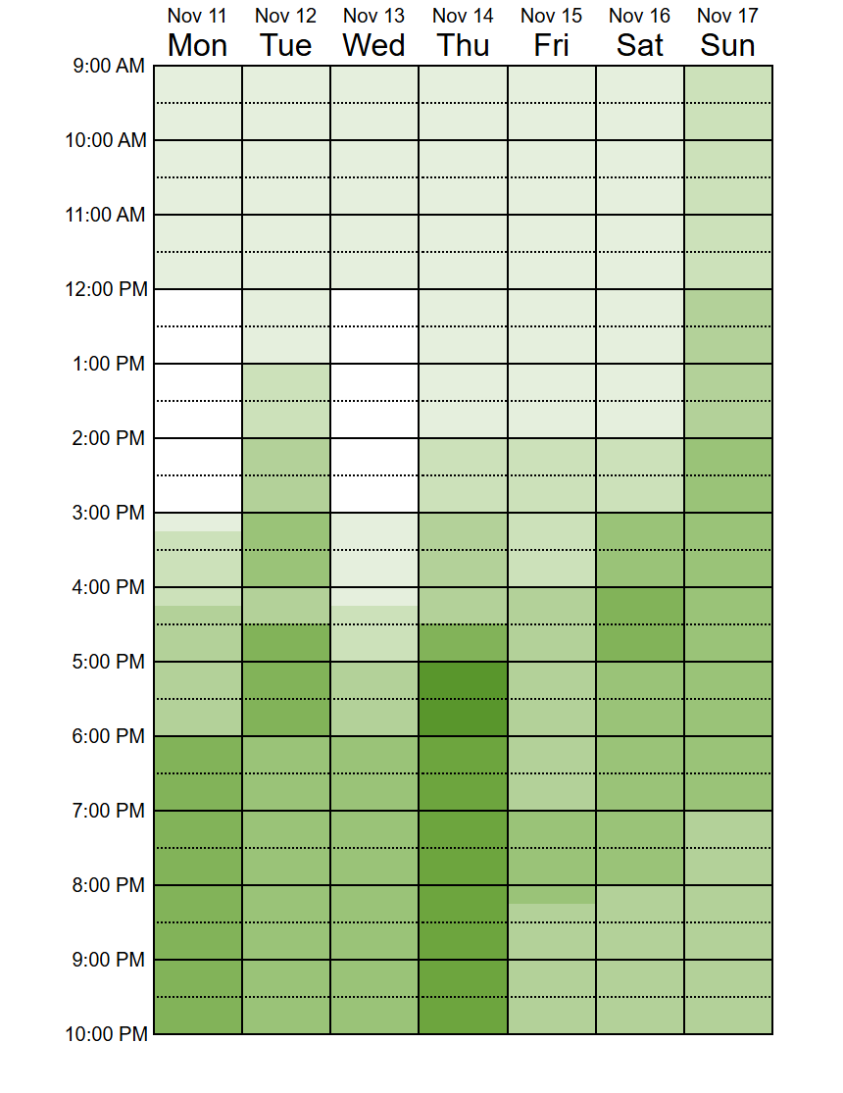
Problems | Brainstorming
User inforamtion
is not stored
UI is uncomfortable
Problems of
When2meet
If the URL is lost,
unable to access it
Need to create
separate accounts
for each appointment

Slide 4
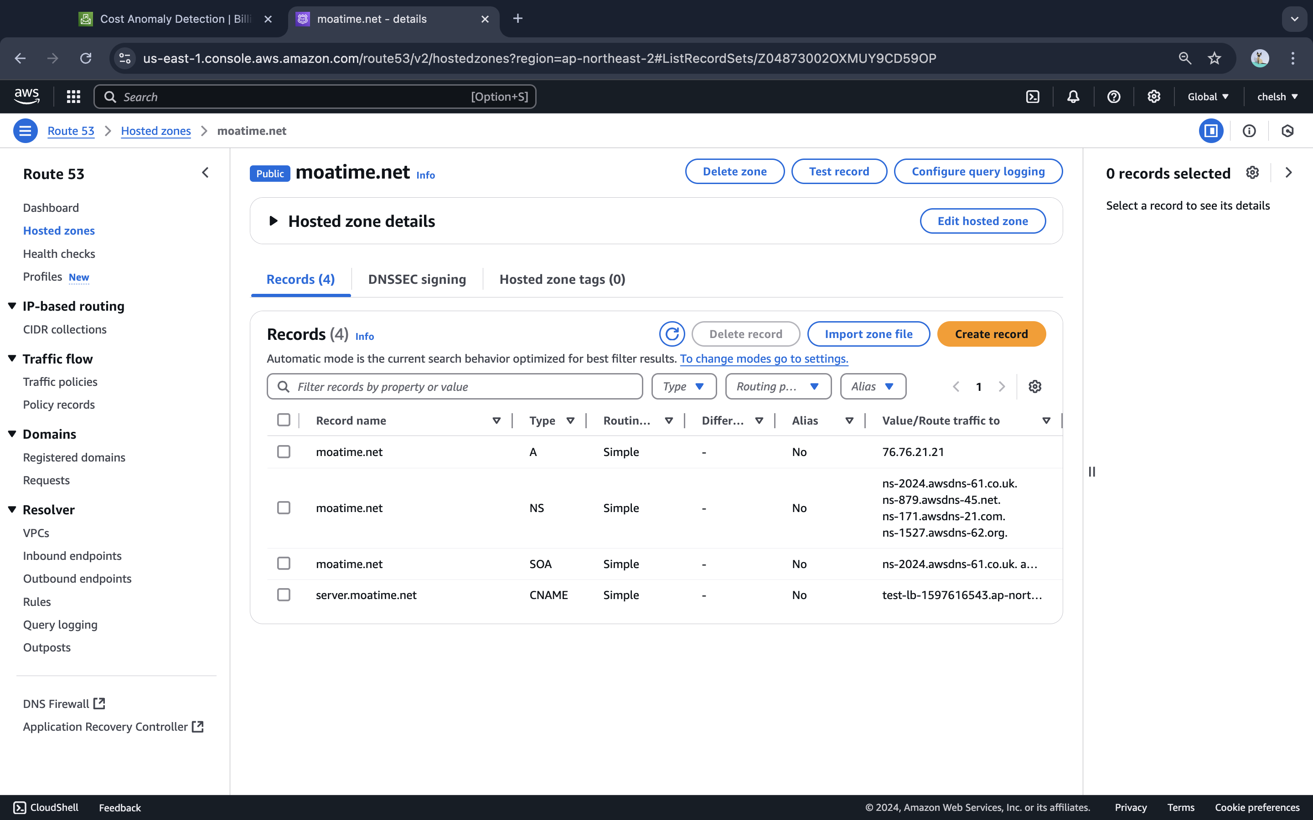
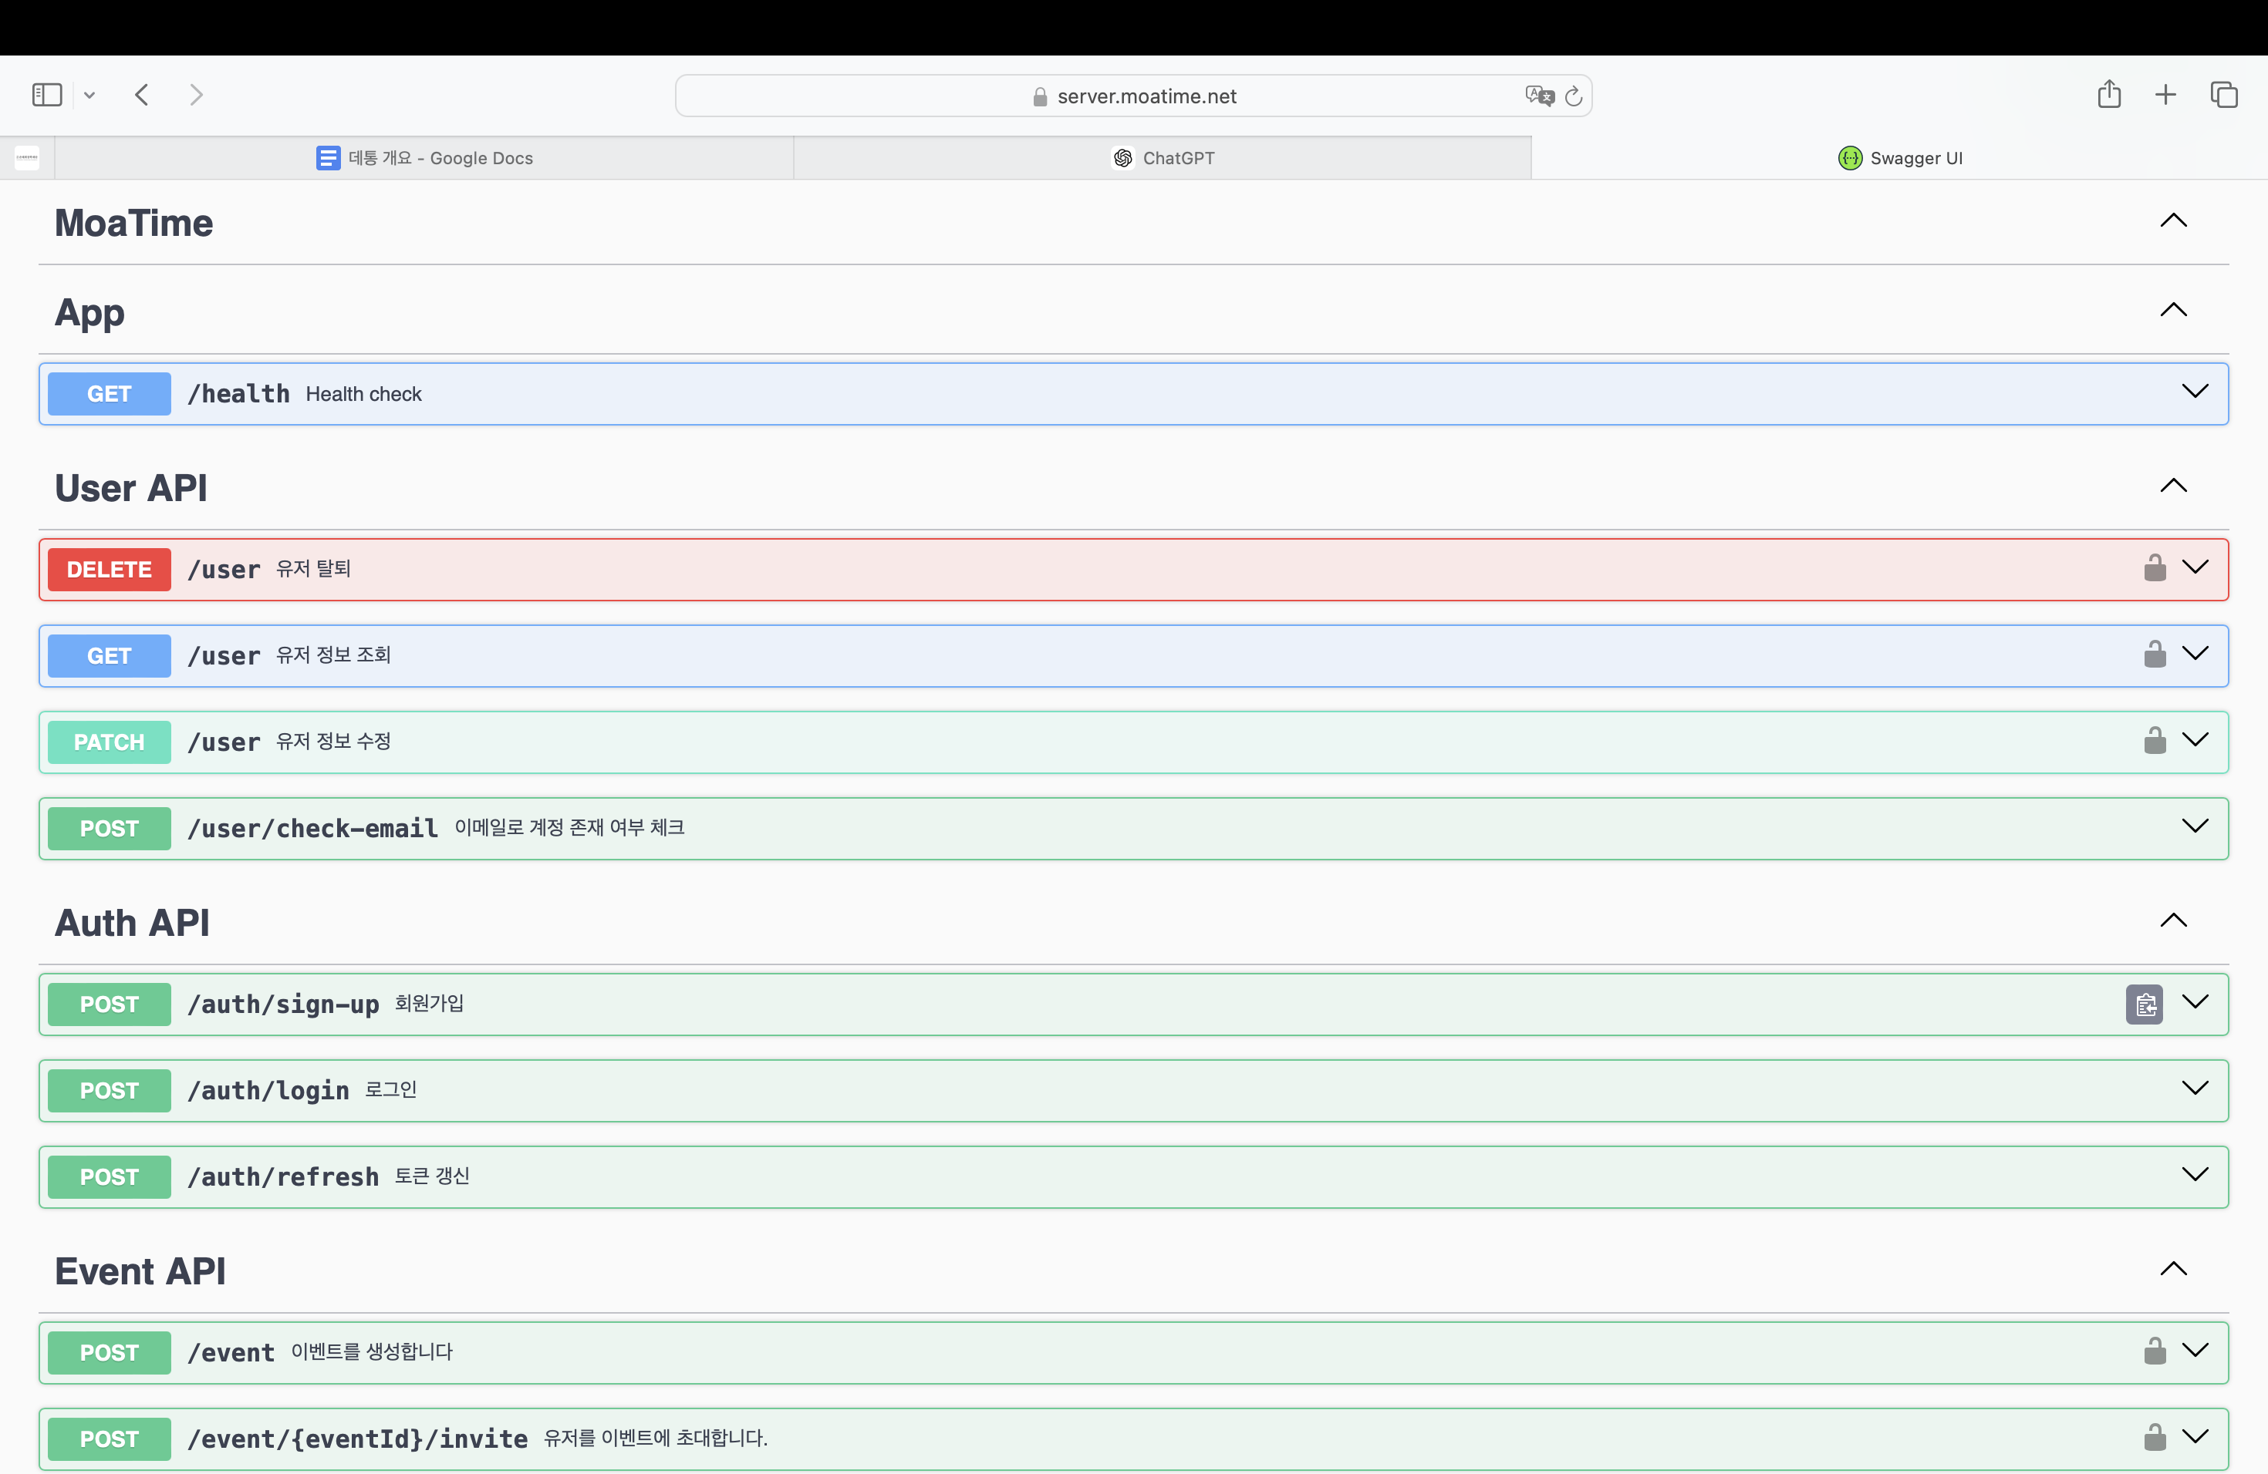
SSL / HTTPS
Purchased the domain “moatime.net”
Linked SSL certificates to it
HTTPS communication
.
Methodology
API
← Swagger API list
Server is hosted on aws EC2
Client-side website is deployed using Vercel

Slide 5
Improvement | Brainstorming
A login service to
store user information
Improved UI for better
usability and visual appeal
Improvements
Hosts can create events and invite users directly, without using links
Users can join or reject
invited events and
joined events are saved
in their mailbox

Slide 6
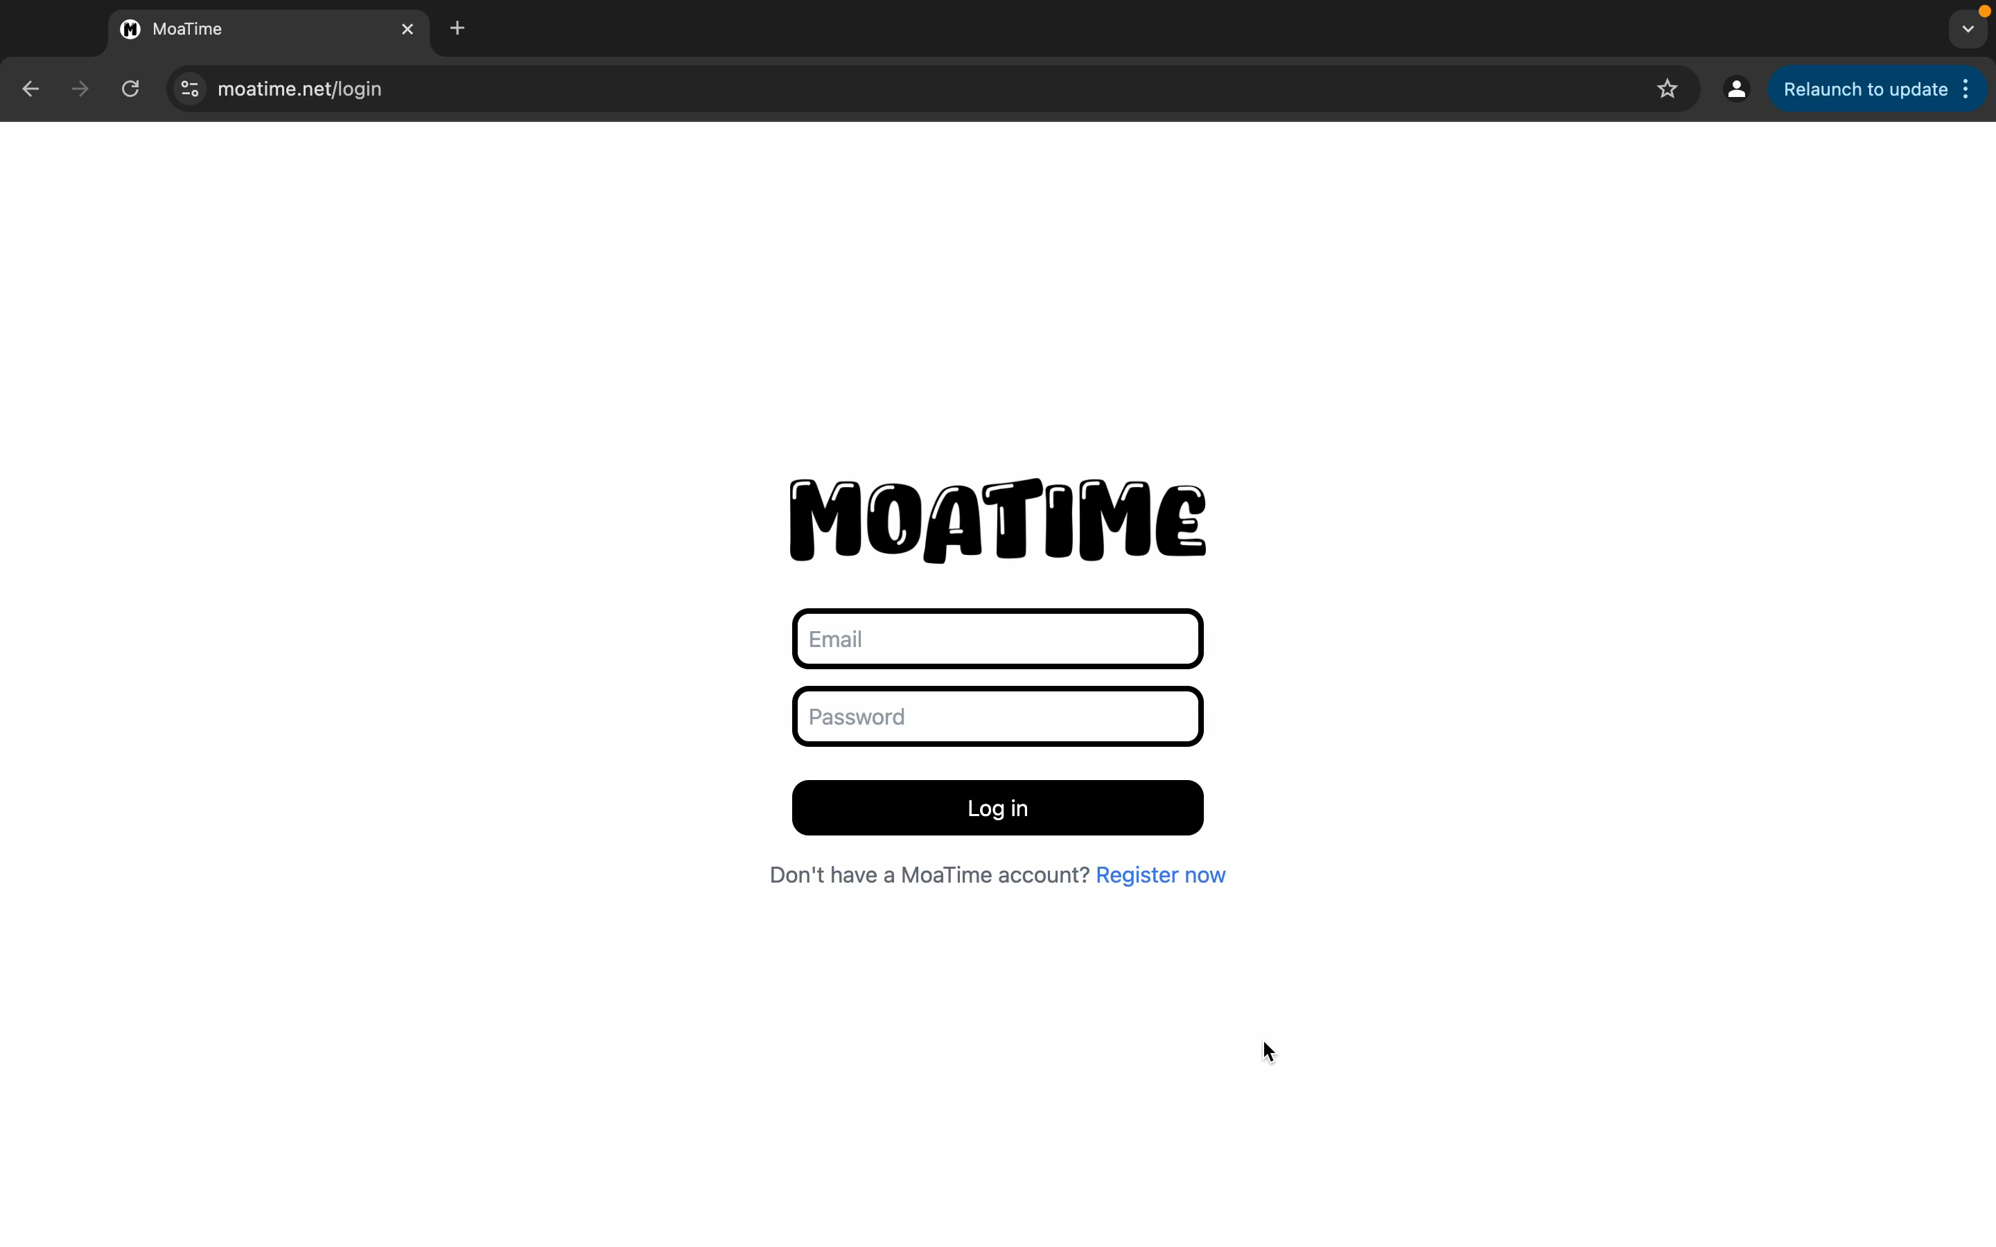
Video link

Slide 7
Future updates will be…
Displaying the times selected by each person separately
Ranking the times based on the most selections

Slide 8
Thank you for listening!

